Slide 1
ViNO DEVELOPMENT
Video Notes

Slide 2
Installing latest dev environment
Official releases
\\gotsnm1502.got.volvocars.net\94050-HMI-Attr-Public-Files\ViNO\releases
Install latest JRE
http://java.com/
Install latest JDK (SE)
http://www.oracle.com/technetwork/java/javase/downloads/index.html
Install latest Eclipse IDE
http://www.eclipse.org/downloads/
Install latest JavaFX
https://www.eclipse.org/efxclipse/install.html#for-the-lazy
Install latest SceneBuilder
http://gluonhq.com/labs/scene-builder/

Slide 3
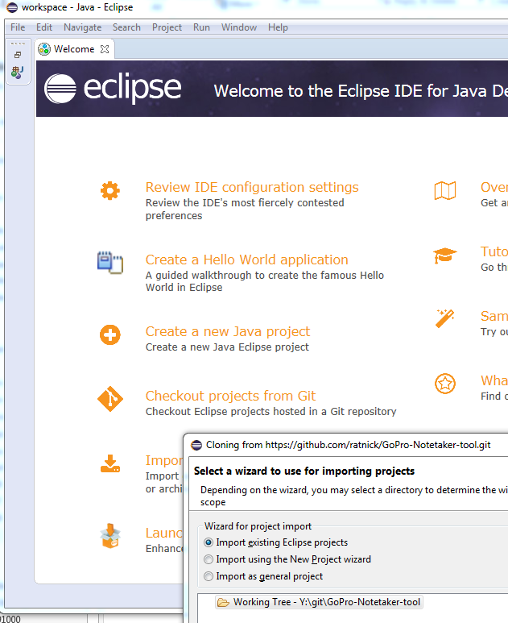
To install from GitHub
Clone from Github (e.g. by starting a new workspace in Eclipse)
WAIT for build to complete
Set up Eclipse (Window=>Preferences
JavaFX => Scenebuilder exe = C:\Users\nnohrras\AppData\Local\SceneBuilder\SceneBuilder.exe

Slide 4
Dependencies & Troubleshooting
When it doesn’t build and compile, it is often related to changes in the latest Java releases that is not backwards compatible with the dependencies.
Check the latest releases of the dependencies and replace them in the build
aspectjrt (https://mvnrepository.com/artifact/org.aspectj/aspectjrt)
httpcomponents (https://hc.apache.org)
isoparser (https://github.com/sannies/mp4parser)
jsoup (https://jsoup.org)
richtextfx (https://github.com/TomasMikula/RichTextFX)
An openly available GoPro wifi API is used
https://github.com/KonradIT/goprowifihack
https://github.com/DomDomHaas/gopro-wifi-API
NNR: When problems: Start downloading latest versions of these dependencies.
If we want to do this automatically, use Maven.

Slide 5
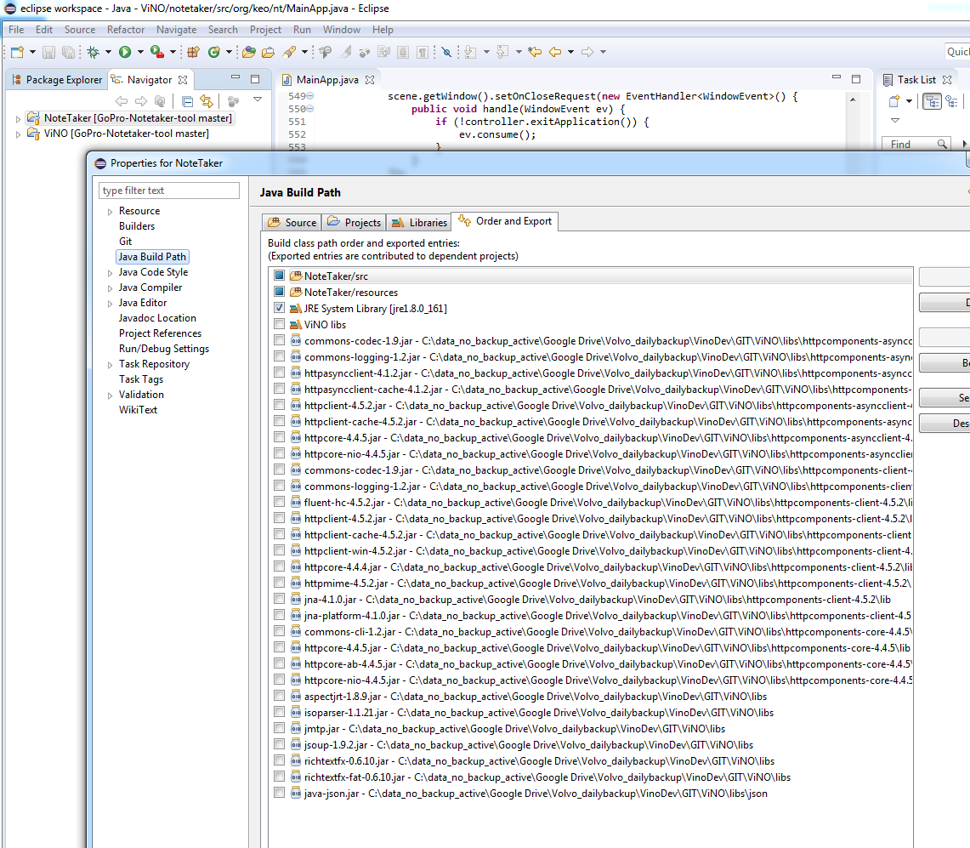
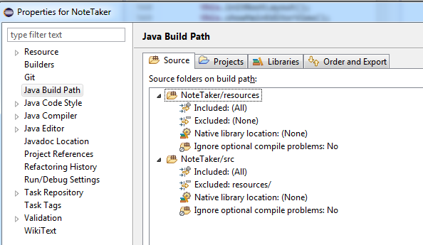
Libraries
Adding libraries in Eclipse:
https://wiki.eclipse.org/FAQ_How_do_I_add_an_extra_library_to_my_project's_classpath%3F

Slide 6
Backlog – bugs
Error description | Entry point to fix
When opening a vino-file, make sure to show the top part. Now it scrolls down to the end. | Check “loadNoteDataFromFile” Move caret position to start of “area”
Recent files doesn’t work | addRecentFilesInPrefs preferenceChange updateRecentFilesMenu
Exiting: pressing cancel closes vino | Works on Mac, Win issue? Check “exitApplication”
Search does not search unless text field is highlighted. | findText
Make it possible to open time-stamps while being in search | Dual focus? Not sure how to attach this one…
Make it possible to open vino files by double-clicking the XML file (consider renaming the file to a .vino file to not open with standard xml viewer). | This is a win/mac thing...change the file extension to for example .vino and associate that with ViNO the application...not sure we can do that on Volvo PC‘s.

Slide 7
Backlog – bugs
Error description | Entry point to fix
Change order of recent file list - newest on top :) | addRecentFilesInPrefs preferenceChange updateRecentFilesMenu
Sometimes search does not work - (will investigate more). Cannot scroll text while search field is open. Show if there are no search results. | findText
After import, timestamps still show old file names (even though timestamps work correctly). | markTimestamps
When changing WIFI from Gopro to VCC, the blue WIFI icon still shows that the camera is connected (even though it is not). Suggestion: Can we monitor if connection to gopro is available? | We need to poll the camera to get a status…it’s possible, but difficult to find the right frequency as different situations will influence the optimal polling frequency. Also, consider each request/reply duration.
Still possible to do time-stamps even if camera is stopped. (er det en emergency-feature eller en bug?) | It’s a bug. Check is camera is recording when inserting timestamp.
Quick Rec / Rec in Vino does not wait for GoPro- Add timeout. So risk of not starting camera when pressing twice. | Check rec status after pressing rec.
If more than 70 files, ”Starting...” won’t disappear. | Look in startRecording() Call to String videoName = mainApp.getGoPro().getMostRecentFileName(); takes too long.

Slide 8
Backlog – improvements
Remove the Merge-file function if not available (or make it work if possible)
GoPro splits video files into several parts when exceeding a certain size. After importing videos, it is possible to merge the videos. Make this work or remove the function.
Remember to update timestamps accordingly.
Merge is started with the merge view that will set the mergeflag which indicates a desired merge to take action when ready. The root layout view will check this flag and initiate a post import parsing of the video files directory. Parsing of the directory detects all chaptered (split) files that need merging and call the merge function on each array of chapters.
Add a toggle switch to swith between compiled and un-compiled timestamps.
Real time compile timestamps to avoid having un-compiled timestamps?
Add highlight or change cursor to Hand when mouse over button.
Add action handlers in mainEditorView and associate them to mouse over/exit
Call setCursor on the scene on primarystage
Add a "Stop Import" button. Now you cannot stop the ongoing import and it can take very long time.
Check „startCopyTask”
Would it make sense to create a folder structure when importing?
startCopyTask
Can we set the time on the GoPro when connecting to the camera?
Check the WIFI API
Add instructions about moving data from memory card
When importing video files, existing files are overwritten (if they were already downloaded once). Can we have a prompt (skip/overwrite)?
handleImportVideoFiles
Could we have a copy+compress function? Possibly combined with Merge.
Check mp4parser documentation how to do this.

Slide 9
Backlog – part 2
Improvements
Can note-taker remember link to video files, so you easily can skip between different xml files without having to redirect to video folder every time?
Could sound be played in both earphones when just selecting one channel during playback?
General: How can we improve communication between GoPro and in NoteTaker, so that it displays the right status ALWAYS?
Create test framework
Integrate Maven support
Improve import speed
Finalize and mature video merge

Slide 10
Architecture
Some initial hints:
All UI is built using JavaFX that provides many benefits and eases general UI implementation.
The Rootlayout is the top layer in which the maineditorview lives as a child.
All other windows are spawned/instantiated as parallel windows.
The texteditor is based on an open source component called RichTextFX that enables attributing text with the necessary features such as active customizable text links. This is also an essential element of the ViNO concept, and creates a direct reference to a specific time in a specific video.
A certain logic is required to create a valid reference.
ViNO imports the video in order to know the location
ViNO controls the GoPro in order to know start, stop and filename
ViNO manages chaptered videos and timestamps that doesn’t reflect chapters

Slide 11
Architecture
MainApp
- The MainApp instantiates all views that require a window
CompiledView
- Shows the video GUI
RootLayout
- The basic window and menubar
MainEditorView
- The graphical UI content
GetStartedView
- A quick introduction to ViNO
ImportVideosView
- Importing videos from the camera or memory card
MediaView
- Not used, see CompiledView instead
NoteDetailsView
- Meta data GUI

Slide 12


Architecture
X view
The MainApp controls the views – it creates them based on the fxml and it kills the instances when not needed.
The MainApp ref is passed to all views, so that they can reach public functions defined in MainApp. Other refs can also be shared through MainApp if needed.
Global variables are defined as MainApp class members and shared through get/set or other functions.
Y view
MainApp
Z view

Slide 13
Call hierachy
RootLayout
MainApp
MainEditorViewCtrl
RootLayoutController
GoproApi
GoProHelper
ENCameraxxx
BacPac
BackPacStatus
Session
Note
Utils
TimeStamp

Slide 14
Power On Call hierachy
RootLayout
MainEditorViewCtrl
MainApp
GoproApi
GoProHelper
(camera base info)
BackPacStatus
HttpClient
Core.Operations
GoProOverlay
WiFiOperations
connectToGP()
ConnectToGoProWifi():
https://github.com/KonradIT/goprowifihack/blob/master/HERO3/WifiCommands.md
getGoPro()
GoProAIP()
1.powerAndWaitUntilIsReady()
powerOn()
turnOnCamera():
sendCommand(OPERATIONS.BACPAC_PW, “%01”)
sendGET()
Execute()
getStatusLine().getStatusCode()
getContentLength()
getContent()
getCameraBaseInfo()
Enum OPERATIONS.BACPAC_PW
2.verifyIfGoProIsReadyToRecord()
getCameraBaseInfo():
getBacpacStatus()
getCameraReady()
RootLayoutController
ENCameraxxx
BackPack
Session
(recording session)
Note
Utils
TimeStamp

Slide 15
Main objects
Mainapp.gopro::GoProAPI
GoProHelper::GoProHelper
mClient::HttpClient
activeGoProAPI::GoProAPIconstants

Slide 16
GoPro status
These status fields are used by GoProApi:
verifyIfGoProIsReadyToRecord use bacpacStatus.getCameraReady()
verifyIfGoProIsPowerOn use bacpacStatus.getCameraPower()
isGoProRecording use gpstat.getShutter()
verifyIfGoProIsRecordingNEW use gpstat.getShutter()
verifyIfGoProIsRecording use bacpacStatus.getShutterStatus()
verifyIfGoProIsReadyToReceiveCmd use bacpacStatus.getBOSSReady()
isGoProReadyToReceiveCmd use bacpacStatus.getBOSSReady()

Slide 17
Upgrade to HERO 5
Determine GoPro version during initiation
Implement Code pairing
https://github.com/KonradIT/goprowifihack/blob/master/HERO4/WifiCommands.md#code-pairing
Set wifi password
https://github.com/KonradIT/goprowifihack/blob/master/HERO4/WifiCommands.md#set-gopro-wifi-namepassword
Map existing HERO3 commands

Slide 18
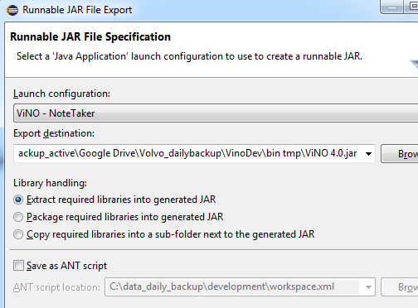
Source code and build
GIT folder: \VinoDev\GIT Do NOT use the sub-folders.
Old versions: E:\VinoDev archive\GIT
To generate a jar, you have to invoke File -> Export -> Jar File wizard
Use VinoDev\bin tmp as output
If it fails, try Project => Clean and try again

Slide 19
Git specifics
If problems updating/mergin binary files (e.g. this power point):
https://stackoverflow.com/questions/278081/resolving-a-git-conflict-with-binary-files
nnohrras@HER100DG5K662 MINGW64 /c/data_no_backup_active/test github/GIT/GoPro-Notetaker-tool (master)
$ git pull origin master
From https://github.com/ratnick/GoPro-Notetaker-tool
* branch master -> FETCH_HEAD
warning: Cannot merge binary files: ViNo Get Started DEVELOPMENT V4.0.pptx (HEAD vs. edf7986a34baa7729f84ad8a22d199dae955539e)
Auto-merging ViNo Get Started DEVELOPMENT V4.0.pptx
CONFLICT (content): Merge conflict in ViNo Get Started DEVELOPMENT V4.0.pptx
Automatic merge failed; fix conflicts and then commit the result.
nnohrras@HER100DG5K662 MINGW64 /c/data_no_backup_active/test github/GIT/GoPro-Notetaker-tool (master|MERGING)
$ git commit -a -m "fix merge conflict in powerpoint binary file"
[master 10592da] fix merge conflict in powerpoint binary file
Author: Nikolaj NÃ¸hr-Rasmussen <nikolaj@noehr-rasmussen.dk>
nnohrras@HER100DG5K662 MINGW64 /c/data_no_backup_active/test github/GIT/GoPro-Notetaker-tool (master)
$ git push origin
Fatal: HttpRequestException encountered.
An error occurred while sending the request.
Counting objects: 4, done.
Delta compression using up to 8 threads.
Compressing objects: 100% (4/4), done.
Writing objects: 100% (4/4), 98.51 KiB | 0 bytes/s, done.
Total 4 (delta 3), reused 0 (delta 0)
remote: Resolving deltas: 100% (3/3), completed with 2 local objects.
To https://github.com/ratnick/GoPro-Notetaker-tool.git
edf7986..10592da master -> master

Slide 20
Tips
Import library into Eclipse
Download the ZIP file from this URL and extract it to get the Jar. Add the Jar to your build path. To check the available classes in this Jar use this URL.
To Add this Jar to your build path Right click the Project > Build Path > Configure build path> Select Libraries tab > Click Add External Libraries > Select the Jar file Download

Slide 21
Manual commands to gopro
Set gopro in ”connect to new app”
Attach it to wireless on PC
Remove LAN cable on PC (to make sure that only one connection is available)
Start PostMan app
Send startup sequence
http://10.5.5.9/bacpac/cv
http://10.5.5.9/gp/gpControl/command/wireless/pair/complete?success=1&deviceName=TEST
Other examples
http://10.5.5.9/gp/gpMediaList (note – works ONLY when not recording)
http://10.5.5.9/gp/gpControl/command/shutter?p=1
http://10.5.5.9/gp/gpControl/status

Slide 22
WiFi connection
Wifi connection has a strong tendency to get lost.
Ensure top prio:
Netsh commands from https://www.howtogeek.com/131640/how-to-change-the-priority-of-wireless-networks-in-windows-8/
get adapter name, profile names and priorities
Netsh wlan show profiles
Set profile to prio 1:
netsh wlan set profileorder name="GP24811169" interface="Wireless Network Connection" priority=1
BUT: the VCCnetP is defaulted to top prio by company policy. So this won’t work on VCC premises.
Refresh wifi profiles list
Show current list
Netsh wlan show networks
netsh interface set interface name=" Wireless Network Connection " admin=disabled
netsh interface set interface name=" Wireless Network Connection " admin=enabled
netsh wlan show networks
Just disconnect + reconnect if you know the network is there: (https://superuser.com/questions/889414/force-refresh-re-scan-wireless-networks-from-command-line)
Netsh wlan disconnect
Netsh wlan connect name=GP24811169

